Slide 1

Smart phone-based URINE CONDUCTIVITY TEST KIT
NATIONAL INSTITUTE OF TECHNOLOGY AGARTALA
ELECTRONICS AND INSTRUMENTATION ENGINEERING
4TH YEAR PROJECT WORK
1

Slide 2
Team members
Group 6
Under the able guidance of Dr. Subir Das
Adyatrayee Roy (21UEI057)
Shreya Mukherjee (21UEI075)
Chandrayee DasGupta(21UEI067)
Tapalabdha Roy (21UE1038)
2

Slide 3
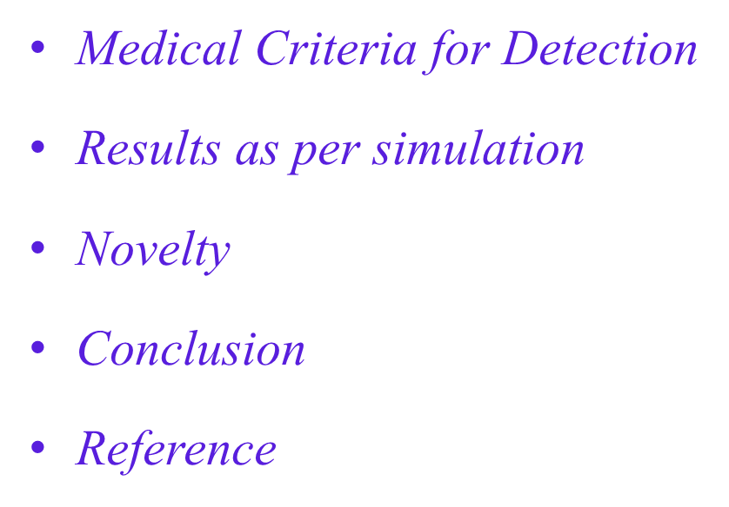
TABLE OF CONTENTS
Introduction
Drawback of Previous Model
Methodology
Components Required and Specification
Technical Architecture
3

Slide 4
AIM & OBJECTIVE
To develop a portable, low-cost, and easy-to-use system for measuring urine conductivity.
To enable early detection of health conditions through urine analysis using a smartphone interface.
To offer a semi-automated and real-time diagnostic solution, especially for use in remote or resource-limited settings.
4

Slide 5
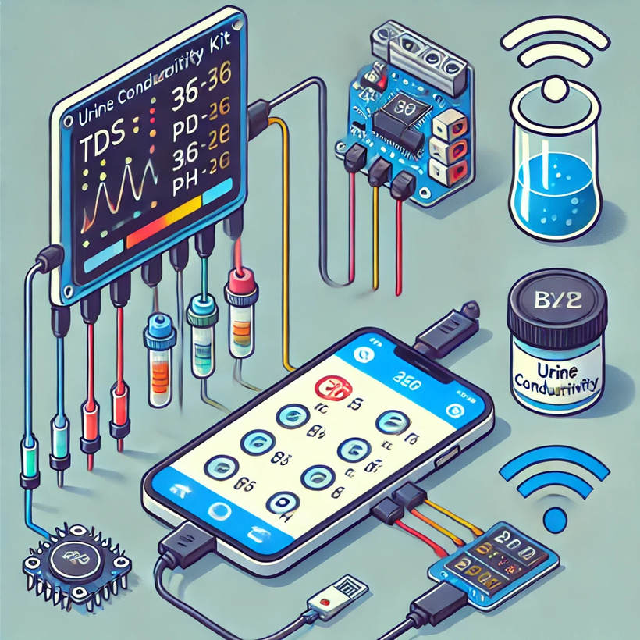
INTRODUCTION
Urine osmolality and electrolyte concentration are key indicators of water and sodium balance.
A portable, handheld kit is proposed to enable real-time analysis through smartphone integration.
This user-friendly device allows patients to monitor their health immediately and continuously at home.
Importance of Electrical Conductivity in Urine Analysis
Electrical conductivity (or resistivity) is a key parameter for estimating the total ion concentration in biological fluids like urine.
The presence of ions in urine directly affects its ability to conduct electrical current.
The relationship between ionic concentration and conductivity is non-linear, making it a sensitive indicator of urine composition and kidney function.
5

Slide 6
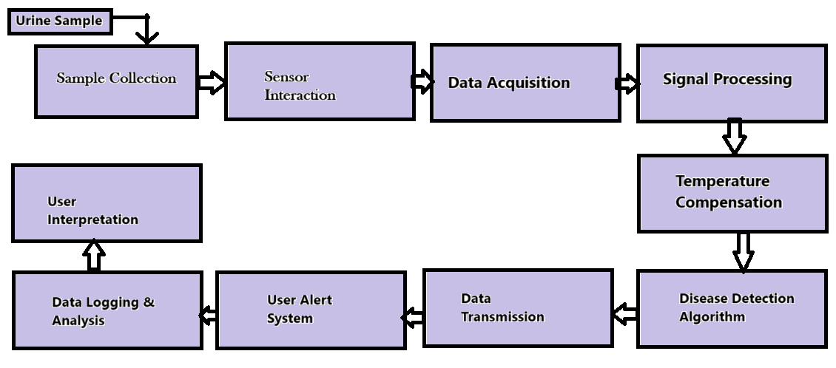
BLOCK DIAGRAM AND METHODOLOGY
6

Slide 7
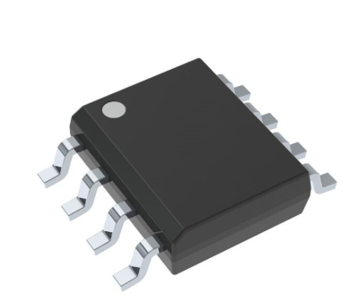


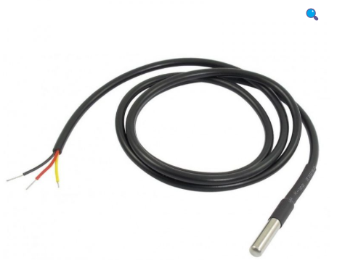

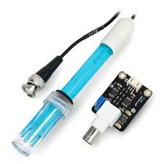
COMPONENTS REQUIRED
LM334
Arduino NANO
HC-05
DSB18B20 TEMPERATURE SENSOR
MIT APP INVENTOR
ANALOG PH SENSOR
7

Slide 8
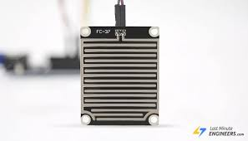
COMPONENT SPECIFICATION
LM- 334 + RAIN CONDUCTIVITY PLATE
FEATURES
• Operates From 1V to 40V
• 0.02%/V Current Regulation proportional to absolute temperature (°K). The
• Programmable From 1μA to 10mA
• True 2-Terminal Operation
• Available as Fully Specified Temperature Sensor
• ±3% Initial Accuracy
• LM334 is specified over a temperature range of 0°C to +70°C
Conductivity Sensor Plate
• Operating voltage:5V
• Material FR – 04
• Driver Size(mm): 32x15x9 (LxWxH)
• Collector Board Size(mm):54x40x1.5 (LxWxH)
• Weight :50 grams
Fig 1:LM334
Fig 2:Conductivity sensor plate
8

Slide 9
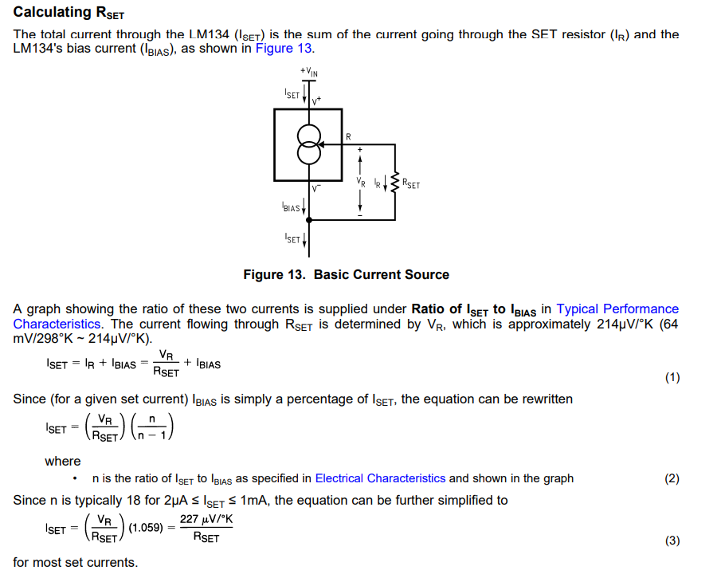
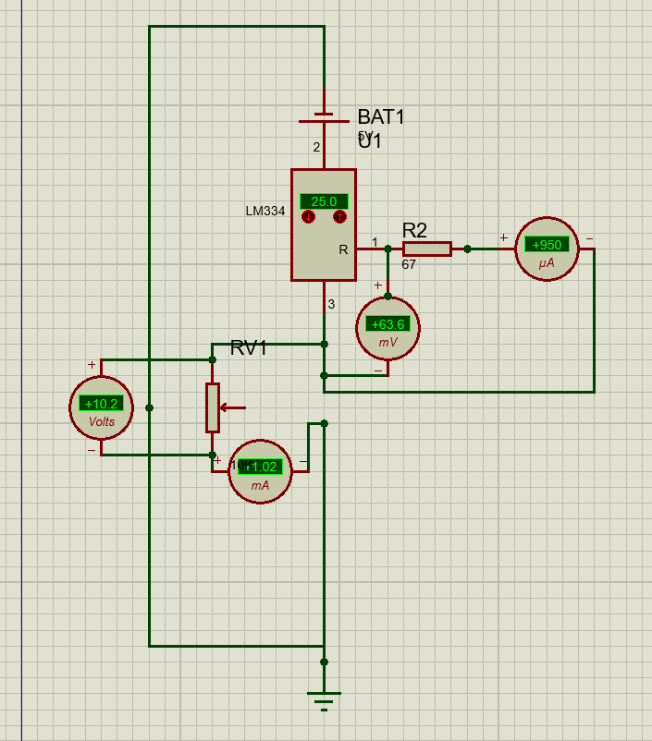
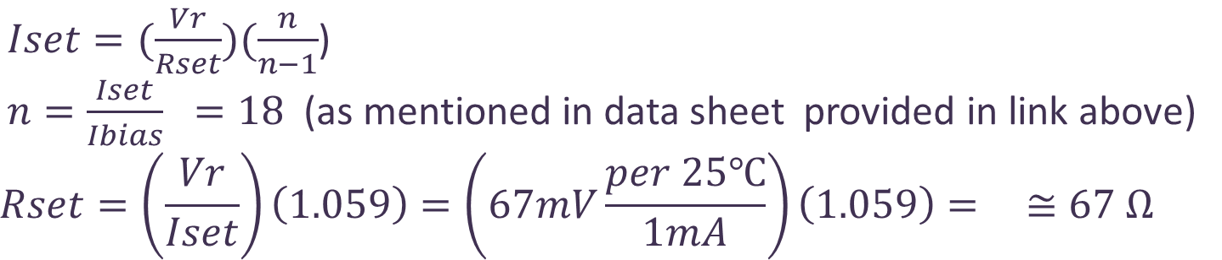
Fig 3: https://www.ti.com/lit/ds/symlink/lm334.pdf
Fig 4: Proteus simulation of LM334 + Conductivity Sensor
9

Slide 10
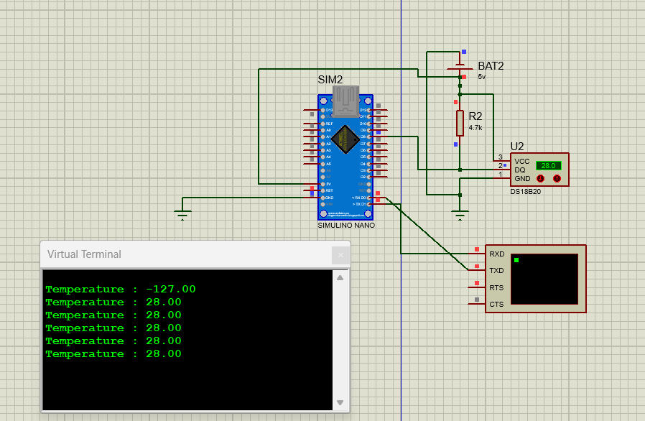
DSB18B20 Temperature Sensor Module
FEATURES
Unique 1-Wire interface requires only one port pin for communication
Multidrop capability simplifies distributed temperature sensing applications
Requires no external components
Can be powered from data line. Power supply range is 3.0V to 5.5V
Zero standby power required
Measures temperatures from -55°C to +125°C. Fahrenheit equivalent is -67°F to +257°F
±0.5°C accuracy from -10°C to +85°C
Thermometer resolution is programmable from 9 to 12 bits
Converts 12-bit temperature to digital word in 750 ms (max.)
Fig 5: https://cdn.sparkfun.com/datasheets/Sensors/Temp/DS18B20.pdf
Fig 6:Proteus Simulation of Temperature Sensor
10

Slide 11
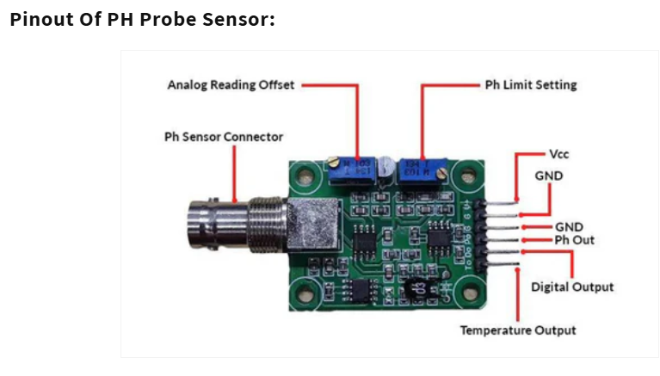
Analog pH Sensor
Fig 7: Analog PH sensor
Operating voltage 5±0.2V (AC - DC)
Working current 5-10mA
The detection concentration range PH0-14
The detection range of temperature :0-60 centigrade
Response Time ≤ 5S
Stability time ≤ 120S
Power consumption ≤ 0.5W
Size :42mm x 32mm x 20mm
Weight : 25g
Fig 8:Pin Out Ph Probe Sensor
11

Slide 12
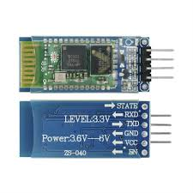
HC-05 Bluetooth Module
Communication Protocol: UART; Bluetooth Version: V2.0 + EDR; Operating Voltage: 3.3V to 5V; Current: 30mA (typical), 50mA (max); Range: Up to 10m (open space); Baud Rate: Default 9600 bps (configurable 1200-1382400 bps); Operating Frequency: 2.4GHz ISM band; Modes: Master/Slave; Dimensions: 37.3mm x 15.5mm x 3.5mm.
Fig 9:Bluetooth Module
12

Slide 13
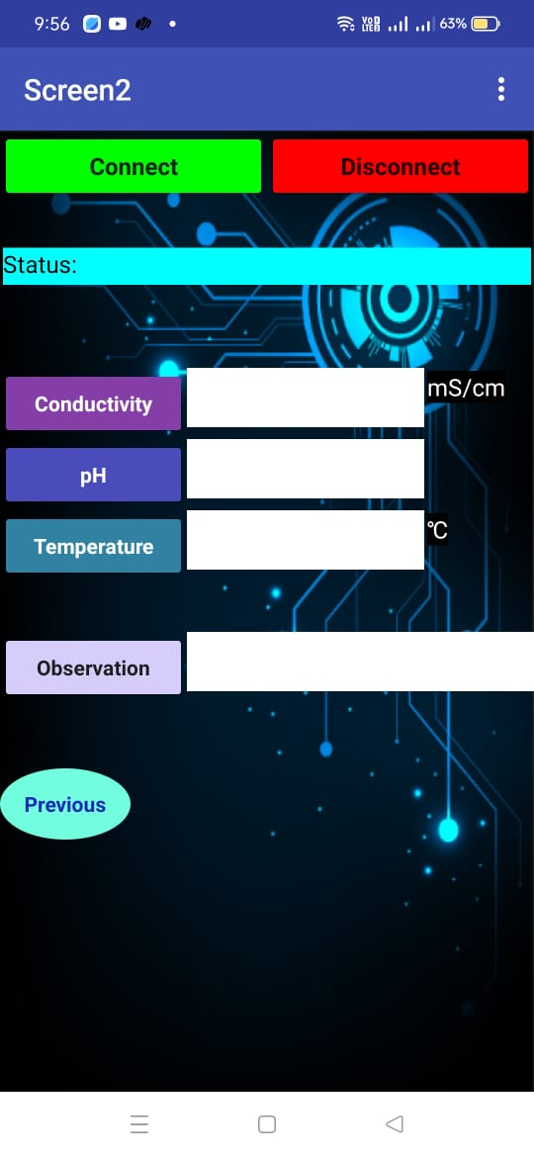
MIT App Inventor
FEATURES
Real time measurement display
Bluetooth Connectivity
Measurement Functionality
User-Friendly Interface
Status Indicator
Handheld and can be easily operated by the user
Fig 10: User Interface
13

Slide 14
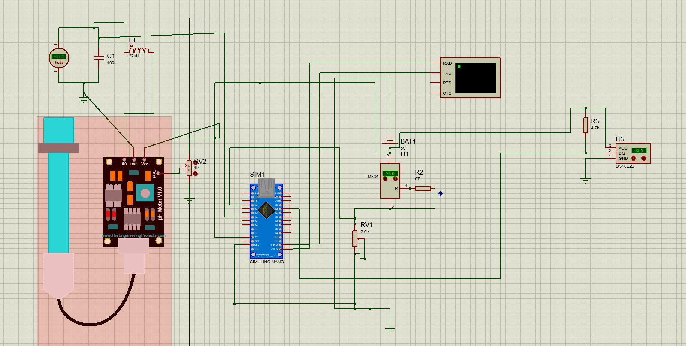
Technical architecture
14

Slide 15
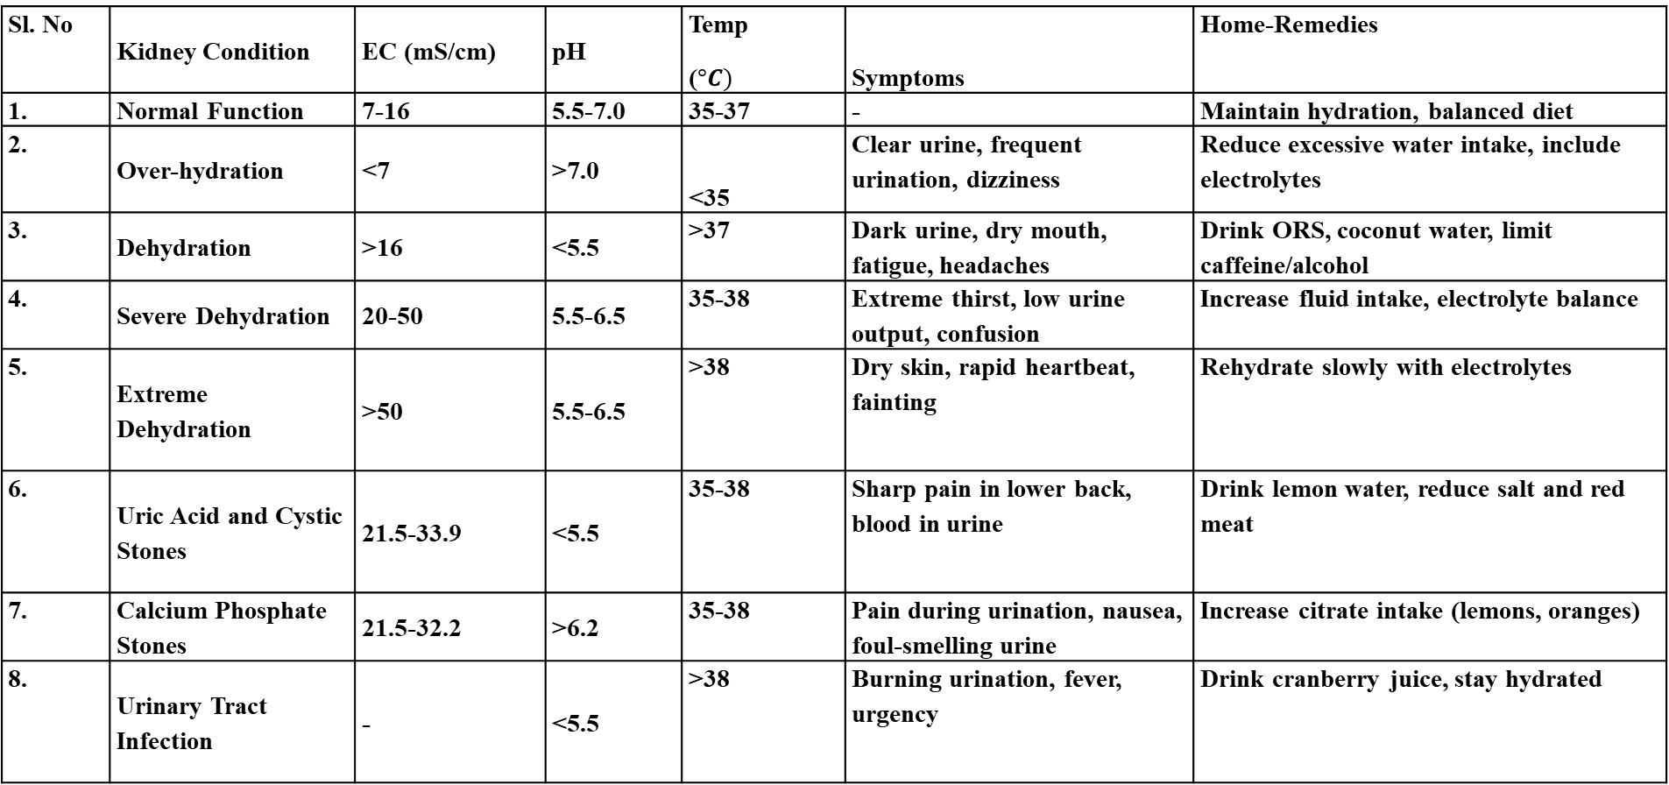
MEDICAL CRITERIA FOR DETECTION
Sl. No | Kidney Condition | EC (mS/cm) | pH | Temp ($°C)$ | Symptoms | Home-Remedies
1. | Normal Function | 7-16 | 5.5-7.0 | 35-37 | - | Maintain hydration, balanced diet
2. | Over-hydration | <7 | >7.0 | <35 | Clear urine, frequent urination, dizziness | Reduce excessive water intake, include electrolytes
3. | Dehydration | >16 | <5.5 | >37 | Dark urine, dry mouth, fatigue, headaches | Drink ORS, coconut water, limit caffeine/alcohol
4. | Severe Dehydration | 20-50 | 5.5-6.5 | 35-38 | Extreme thirst, low urine output, confusion | Increase fluid intake, electrolyte balance
5. | Extreme Dehydration | >50 | 5.5-6.5 | >38 | Dry skin, rapid heartbeat, fainting | Rehydrate slowly with electrolytes
6. | Uric Acid and Cystic Stones | 21.5-33.9 | <5.5 | 35-38 | Sharp pain in lower back, blood in urine | Drink lemon water, reduce salt and red meat
7. | Calcium Phosphate Stones | 21.5-32.2 | >6.2 | 35-38 | Pain during urination, nausea, foul-smelling urine | Increase citrate intake (lemons, oranges)
8. | Urinary Tract Infection | - | <5.5 | >38 | Burning urination, fever, urgency | Drink cranberry juice, stay hydrated
Fig 11: Y. M. F. Marickar, "Electrical conductivity and total dissolved solids in urine," Urological Research, vol. 38, no. 4, pp. 233–235, Aug. 2010
15

Slide 16
RESULT AND DISCUSSION Stability test
Fig 13: Temperature(ºC) vs Time(min)
Fig 12: Conductance(mS) vs Time(min)
Fig 14: pH vs Time(every 10 min)
Interpretation:
The temperature starts at 28.25°C and gradually decreases to around 27.62°C, with minor fluctuations over the 140-minute period.
The curve stabilizes between 27.6°C and 27.9°C for most of the duration.
These small changes suggest environmental stabilization and the sensor's good precision
Interpretation:
Very minimal drift observed over the test duration of 130 minutes
No sudden spikes or dips, indicating stable sensor response over time.
Stability over time reflects the sensor’s robust performance under controlled conditions
Interpretation:
The values stayed within a narrow range of ±0.0026 mS/cm.
Initial fluctuation from 0.047 to 0.055 mS/cm in the first 10 minutes.
The device demonstrated excellent signal stability with negligible drift.
16

Slide 17
Precision TEST
Fig 16: Temperature(ºC) vs Trial No.
Fig 17: pH Vs Trial No
Conductivity Sensor
Standard Deviation: ± 0.026511
Indicates the spread or variation in the readings from the mean.
A smaller SD reflects more consistent and repeatable measurements.
Precision is considered as ±2 × SD = ±0.0530
DS18B20 Temperature Sensor
The mean temperature recorded is 27.82°C, indicating a stable thermal environment during the test period.
A standard deviation of 0.17°C highlights minimal variation, showing the system's high consistency.
With a precision of ±0.34°C, the system demonstrates strong potential for accurate biomedical monitoring applications
Analog Ph Sensor
Stability over time reflects the sensor’s robust performance under controlled conditions.
Increased slightly to a maximum of 8.21, then stabilized between 8.15–8.20 after 50 minutes
Fig 15: Conductivity(mS/cm) vs Trial No
17

Slide 18
REPEATABILITY TEST
Fig 18: Conductivity(mS/cm) vs Trial No
Fig 20: pH vs Trial No.
Fig 19: Temperature(ºC) vs Trial No
Conductivity Sensor
The mean conductivity value recorded was 0.0488 mS/cm, with a standard deviation of 0.002651 mS/cm, indicating the spread of values is quite minimal.
The coefficient of variation (CV%) is 5.43%, which is acceptable and signifies that the measurement system shows reasonable consistency but may be slightly influenced by experimental conditions
DS18B20 Temperature Sensor
The standard deviation is 0.164 °C, and the calculated precision is ±0.328 °C, which outlines the variation range.
The repeatability, reflected by the CV% of 0.59%, demonstrates excellent sensor stability as it is well below 1%, suggesting the sensor provides highly reliable readings.
Analog Ph sensor
The standard deviation is 0.044, and the calculated precision is ±0.089, which outlines the variation range.
The repeatability, reflected by the CV% of 0.55%, demonstrates excellent sensor stability as it is well below 1%, suggesting the sensor provides highly reliable readings.
18

Slide 19
Accuracy of Conductivity Sensor+LM334
KCl Concentration(M) | Standard Conductivity (mS/cm) at 27ºC | Measured Conductivity (mS/cm) 27ºC | Error (%)
0.1 M | 16.5 | 15.921 | 3.51%
1.0 M | 111.3 | 111.07 | 0.21%
Table 1: Accuracy comparison between standard and measured conductivity
Hence the mean error =1.86% which is acceptable.
KCl is widely used over NaCl for conductivity sensor calibration because it provides stable, well-documented conductivity values recognized by ISO and NIST standards. It fully dissociates without forming secondary compounds, ensuring accurate and repeatable measurements with minimal ion interaction effects.
19

Slide 20
Effect of temperature on the conductivity
Interpretation:
The conductivity of 1 gram of KCl solution increases with temperature, from 15.96 mS/cm at 27°C to 21.00 mS/cm at 41°C.
A temperature rise of 2°C leads to an approximate increase of 0.72 mS/cm in conductivity.
The change in conductivity is gradual, with a total increase of 5.04 mS/cm from 27°C to 41°C.
This pattern reflects the typical behavior of ionic solutions, where higher temperatures enhance the movement of ions, leading to higher conductivity
Temperature (°C) | Conductivity (mS/cm) at KCl
27 | 15.92
29 | 16.68
31 | 17.40
33 | 18.12
35 | 18.84
37 | 19.56
39 | 20.28
41 | 21.00
Table 2:Temperature vs conductivity
Fig 21: Conductivity(mS/cm) vs Temp(ºC)
20

Slide 21
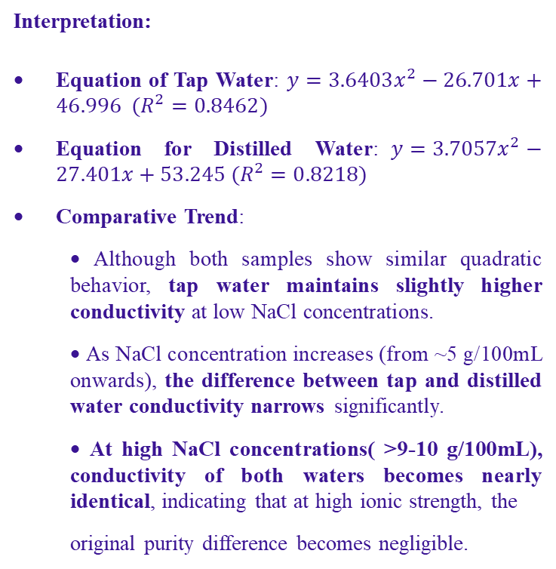
Change in conductivity of solution with addition of NaCl (per gm)
Interpretation:
Equation of Tap Water: $y=3.6403x^{2}−26.701x+46.996 (R^{2}=0.8462)$
Equation for Distilled Water:$y=3.7057x^{2}−27.401x+53.245 (R^{2}=0.8218)$
Comparative Trend:
• Although both samples show similar quadratic behavior, tap water maintains slightly higher conductivity at low NaCl concentrations.
• As NaCl concentration increases (from ~5 g/100mL onwards), the difference between tap and distilled water conductivity narrows significantly.
• At high NaCl concentrations( >9-10 g/100mL), conductivity of both waters becomes nearly identical, indicating that at high ionic strength, the
original purity difference becomes negligible.
 | Conductivity(mS/cm)
NaCl (g/100mL) | Tap Water | Distilled Water
0 |  | 0
1 | 16.486 | 11.2788
2 | 20.155 | 12.3669
3 | 22.602 | 13.5954
4 | 23.665 | 16.2747
5 | 41.056 | 39.7449
6 | 43.343 | 38.5281
7 | 46.683 | 41.652
8 | 65.566 | 70.03035
9 | 110.682 | 104.2061
10 | 260.7111 | 248.9994
Table 3: Comparison between Tap Water and Distilled Water with NaCl (per gm/100ml)
Fig 22: Conductivity(mS/cm) vs NaCl (pergm)
21

Slide 22
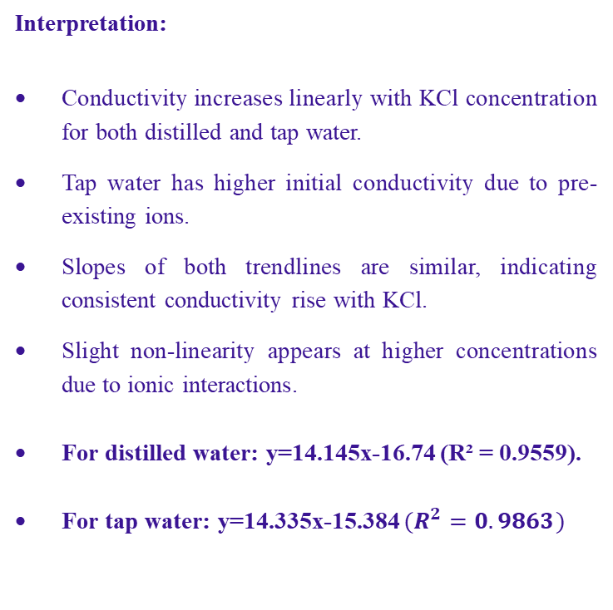
Change in conductivity of solution with addition of KCl (per gm)
Interpretation:
Conductivity increases linearly with KCl concentration for both distilled and tap water.
Tap water has higher initial conductivity due to pre-existing ions.
Slopes of both trendlines are similar, indicating consistent conductivity rise with KCl.
Slight non-linearity appears at higher concentrations due to ionic interactions.
For distilled water: y=14.145x-16.74 (R² = 0.9559).
For tap water: y=14.335x-15.384 $(R^{2}=0.9863)$
KCl (g/100mL) | conductivity(mS/cm)
 | distilled water | tap water
0 | 0.0049 | 1.392
1 | 15.92 | 16.32
2 | 25.562 | 27.823
3 | 37.076 | 39.65
4 | 48.737 | 50.365
5 | 64.65 | 70.65
6 | 72.283 | 75.654
7 | 111.07 | 111.15
Table 4: Comparison between Tap Water and Distilled Water with NaCl (per gm/100ml)
Fig23: Conductivity(mS/cm) vs KCl (pergm)
22

Slide 23
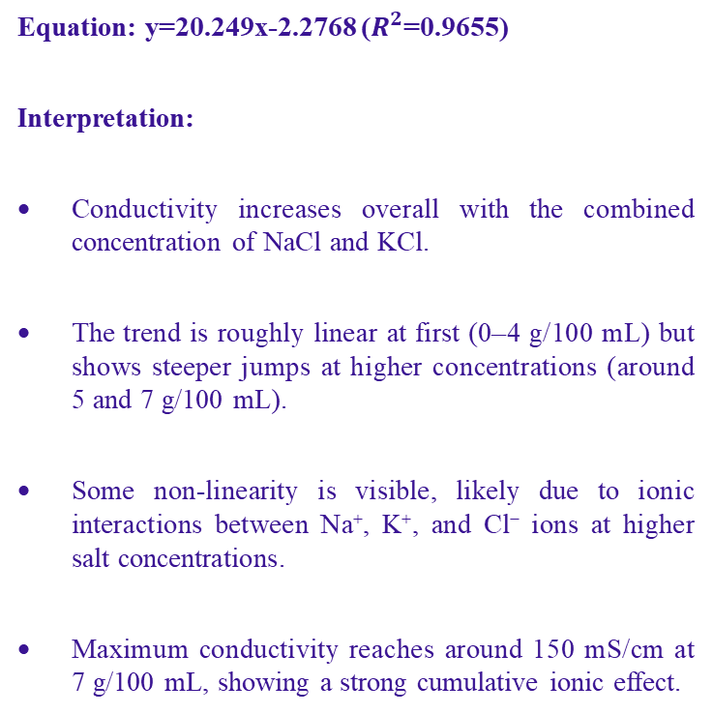
Change in conductivity of solution with addition of NaCl+ KCl (1:1 per gm)
Equation: y=20.249x-2.2768 ($R^{2}$=0.9655)
Interpretation:
Conductivity increases overall with the combined concentration of NaCl and KCl.
The trend is roughly linear at first (0–4 g/100 mL) but shows steeper jumps at higher concentrations (around 5 and 7 g/100 mL).
Some non-linearity is visible, likely due to ionic interactions between Na⁺, K⁺, and Cl⁻ ions at higher salt concentrations.
Maximum conductivity reaches around 150 mS/cm at 7 g/100 mL, showing a strong cumulative ionic effect.
Nacl+kcl(per gm) | Conductivity(mS/cm)
0 | 0
1 | 27.20055
2 | 37.9314
3 | 50.6714
4 | 65.0117
5 | 104.4037
6 | 110.8114
7 | 152.7305
Fig 24: Conductivity(mS/cm) vs NaCl+KCl (pergm)
Table 5: Comparison between NaCl+KCl (per gm/100ml)
23

Slide 24
NOVELTY
REAL-TIME MONITORING:Unlike traditional calorimetric or lab-based urine analysis, which requires sample processing and delays results, the proposed model provides instant readings via a smartphone.
NON-INVASIVE & PORTABLE: Existing methods involve chemical reagents or spectrophotometry, which are costly and require laboratory settings.The proposed handheld, sensor-based device allows on-the-go, non-invasive urine analysis without the need for reagents.
ELIMINATES CHEMICAL DEPENDENCY : Calorimetric methods rely on color changes in reagents, which can be affected by contamination, lighting conditions, or subjective interpretation.
The proposed system directly measures urine pH, conductivity, and temperature using sensors, making it more reliable and precise.
COST-EFFECTIVE & USER-FRIENDLY:Lab-based analysis involves expensive equipment and trained professionals.This model uses affordable Arduino-based components, making it accessible for home-based urine health monitoring.
24

Slide 25
CONCLUSION
The proposed Smartphone-Based Urine Conductivity Test Kit provides a portable, real-time, and user-friendly solution for urine analysis. By integrating pH, electrical conductivity, and temperature sensors with a smartphone interface, the system enables early detection of potential health issues such as dehydration, urinary tract infections, and kidney disorders. This low-cost, non-invasive approach enhances continuous monitoring and empowers users with timely health insights, reducing dependency on traditional laboratory testing.
25

Slide 26
REFERENCES
Y. M. Fazil Marickar, "Electrical conductivity and total dissolved solids in urine," Urological Research, vol. 38, no. 4, pp. 233–235, Aug. 2010.
A. S. M. Suhail, M. A. M. Ali, and M. A. M. Ali, "Development of Low-voltage Urine Sample Conductivity Measurement System for Kidney Stone Risk Assessment," presented at the 2021 IEEE International Conference on Semiconductor Electronics (ICSE), Kuala Lumpur, Malaysia, 2021, pp. 1–4.
M. S. Islam, M. S. Uddin, and M. A. H. Akhand, "Development of Urine Conductivity Sensing System for Measurement and Analysis," in Proceedings of the International Conference on Computing Advancements (ICCA 2019), Dhaka, Bangladesh, 2019, pp. 1–6.
A. S. M. Suhail, M. A. M. Ali, and M. A. M. Ali, "Development of a Portable Multi-Sensor Urine Test and Data Collection Platform for Risk Assessment of Kidney Stone Formation," Electronics, vol. 9, no. 12, p. 2180, Dec. 2020.
Mr. Mayur Badole , Ms. Pallavi Bagde , Ms. Karishma Madame , Ms. Reshma Ninawe , Ms. Akansha Wasnik ,Prof. Mirza Moiz Baig , Prof .Supriya Sawwasere , "A Review on IoT-Based Health Monitoring System," IEEE Transactions on Biomedical Engineering, vol. 67, no. 4, pp. 1120-1135, 2023.
T. Wang, H. Li, and Y. Zhou, "Machine Learning Approaches for Early Kidney Disease Detection," IEEE Transactions on Computational Biology, vol. 19, no. 2, pp. 220-234, 2021.
M. Patel, J. Rao, and R. Kumar, "Development of a Low-Cost Urinalysis System Using IoT," IEEE Sensors Journal, vol. 21, no. 9, pp. 1765-1772, 2022.
26

